Slide 1
Chapter 1
Computer Abstractions and Technology

Slide 2
Understanding Performance
Algorithm
Determines number of operations executed
Programming language, compiler, architecture
Determine number of machine instructions executed
per operation
Processor and memory system
Determine how fast instructions are executed
I/O system (including OS)
Determines how fast I/O operations are executed
Notes:
Until the 8th slide it’s not important

Slide 3
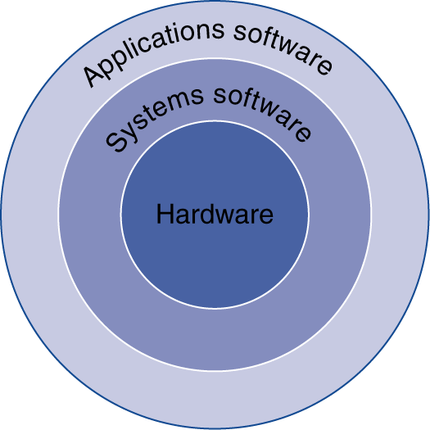
Below Your Program
§1.2 Below Your Program
Application software
Written in high-level language
System software
Compiler: translates HLL code to
machine code
Operating System: service code
Handling input/output
Managing memory and storage
Scheduling tasks & sharing resources
Hardware
Processor, memory, I/O controllers

Slide 4
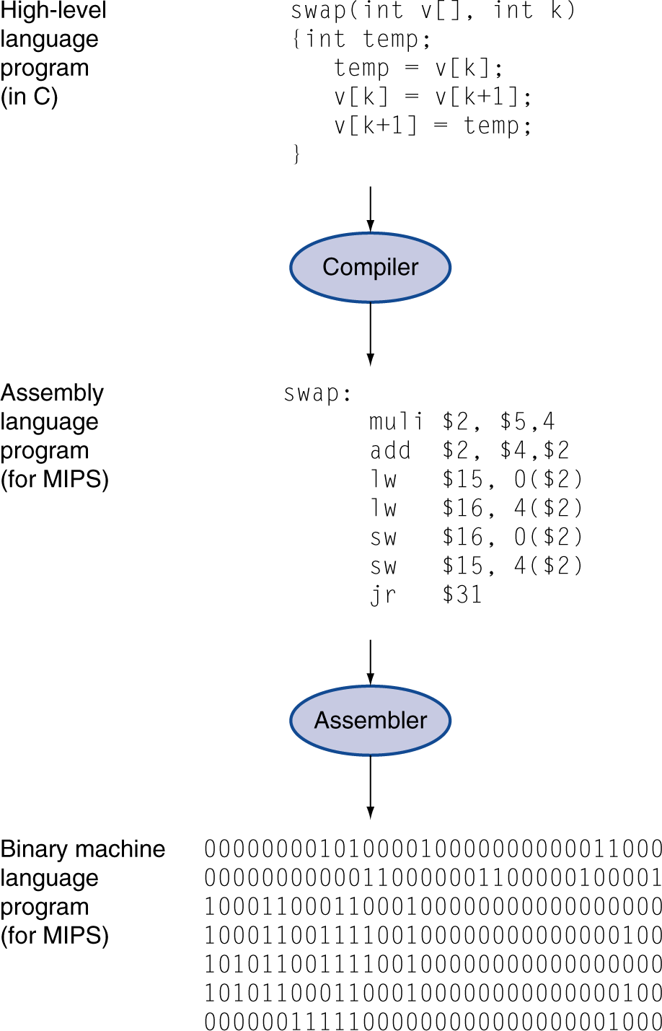
Levels of Program Code
High-level language
Level of abstraction closer to problem domain
Provides for productivity and portability
Assembly language
Textual representation of instructions
Hardware representation
Binary digits (bits)
Encoded instructions and data

Slide 5
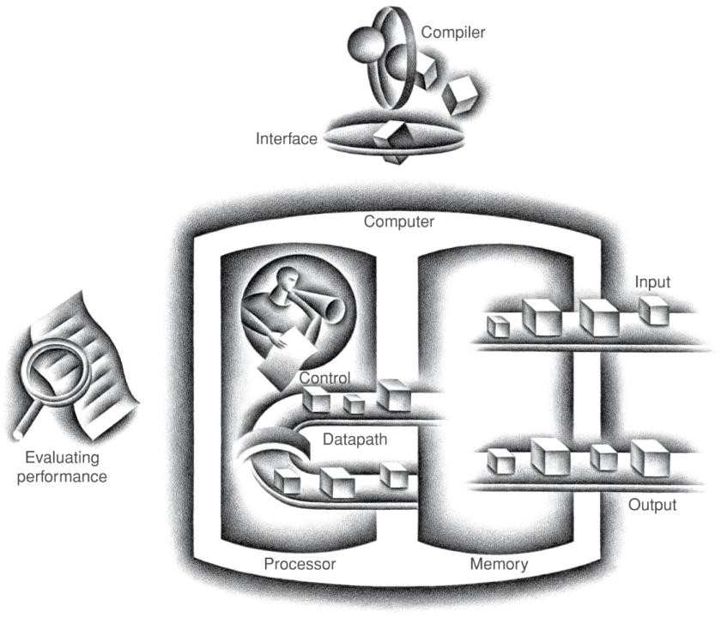
Components of a Computer
§1.3 Under the Covers
The BIG Picture
Same components for all kinds of computer
Desktop, server,
embedded
Input/output includes
User-interface devices
Display, keyboard, mouse
Storage devices
Hard disk, CD/DVD, flash
Network adapters
For communicating with other computers

Slide 6
Abstractions
The BIG Picture
Abstraction helps us deal with complexity
Hide lower-level detail
Instruction set architecture (ISA)
The hardware/software interface
Application binary interface
The ISA plus system software interface
Implementation
The details underlying and interface

Slide 7

Defining Performance
§1.4 Performance
Which airplane has the best performance?
Boeing 777
Boeing 747
BAC/Sud Concorde
Douglas DC-8-50
0 100 200 300 400 500
Boeing 777
Boeing 747
BAC/Sud Concorde
Douglas DC- 8-50
0 2000 4000 6000 8000 10000
Passenger Capacity
Cruising Range (miles)
Boeing 777
Boeing 747
BAC/Sud Concorde
Douglas DC-8-50
Boeing 777
Boeing 747
BAC/Sud Concorde
Douglas DC- 8-50
0
500 1000
1500
0
100000 200000 300000 400000
Cruising Speed (mph)
Passengers x mph

Slide 8
Response Time and Throughput
Response time
How long it takes to do a task
Throughput
Total work done per unit time
e.g., tasks/transactions/… per hour
How are response time and throughput affected by
Replacing the processor with a faster version?
Adding more processors?
We’ll focus on response time for now…

Slide 9
Relative Performance
Define Performance = 1/Execution Time
“X is n time faster than Y”
Performance_{X} Performance_{Y}
= Execution time_{Y} Execution time_{X} = n
Example: time taken to run a program
10s on A, 15s on B
Execution Time_{B} / Execution Time_{A}
= 15s / 10s = 1.5
So A is 1.5 times faster than B
Notes:
These rules are important to understand and practice it

Slide 10
Measuring Execution Time
Elapsed time
Total response time, including all aspects
Processing, I/O, OS overhead, idle time
Determines system performance
CPU time
Time spent processing a given job
Discounts I/O time, other jobs’ shares
Comprises user CPU time and system CPU time
Different programs are affected differently by CPU and system performance
Notes:
Elapsed : المنقضي

Slide 11
CPU Clocking
Operation of digital hardware governed by a constant-rate clock
Clock period
Clock (cycles)
Data transfer and computation
Update state
Clock period: duration of a clock cycle
e.g., 250ps = 0.25ns = 250×10^{–12}s
Clock frequency (rate): cycles per second
e.g., 4.0GHz = 4000MHz = 4.0×10⁹Hz

Slide 12
CPU Time
CPU Time = CPUClock Cycles× Clock Cycle Time
₌ CPUClock Cycles Clock Rate
Performance improved by
Reducing number of clock cycles
Increasing clock rate
Hardware designer must often trade off clock rate against cycle count
Notes:
This rule important to understand and practice and dealing with it

Slide 13
CPU Time Example
Computer A: 2GHz clock, 10s CPU time
Designing Computer B
Aim for 6s CPU time
Can do faster clock, but causes 1.2 × clock cycles
How fast must Computer B clock be?
₌ Clock Cycles_{B =} 1.2 ×Clock Cycles_{A}
Clock Rate
B
CPU Time_{B} 6s
Clock Cycles_{A} = CPU Time_{A} ×Clock Rate_{A}
= 10s× 2GHz = 20×10⁹
1.2 × 20×10⁹ 24×10⁹
Clock Rate_{B} =
= = 4GHz
6s 6s

Slide 14
Instruction Count and CPI
ClockCycles = Instruction Count× Cyclesper Instruction
CPUTime= Instruction Count× CPI×ClockCycle Time
₌ Instruction Count× CPI
ClockRate
Instruction Count for a program
Determined by program, ISA and compiler
Average cycles per instruction
Determined by CPU hardware
If different instructions have different CPI
Average CPI affected by instruction mix

Slide 15
CPI Example
Computer A: Cycle Time = 250ps, CPI = 2.0
Computer B: Cycle Time = 500ps, CPI = 1.2
Same ISA
Which is faster, and by how much?
CPUTim e_{A} = Instruction Count× CPI_{A} ×Cycle Tim e_{A}
= I× 2.0× 250ps= I× 500ps
A is faster…
CPUTim e_{B} = Instruction Count× CPI_{B} ×Cycle Tim e_{B}
= I×1.2× 500ps= I× 600ps
CPUTim e_{B = I× 600ps = 1.2} CPUTim e_{A} I× 500ps
…by this much
Notes:
We discussed about how to calculate the performance in previous slide

Slide 16
CPI in More Detail
If different instruction classes take different numbers of cycles
Clock Cycles = ∑(CPI_{i} ×Instruction Count_{i} )
i=1
n
Weighted average CPI
Clock Cycles Instruction Count
n
= ∑
⎛
Instruction Count
⎞
CPI =
⎜
CPI ×
i
i
Instruction Count ⎟
i=1 ⎝
⎠
Relative frequency

Slide 17
CPI Example
Alternative compiled code sequences using instructions in classes A, B, C
Class | A | B | C
CPI for class | 1 | 2 | 3
IC in sequence 1 | 2 | 1 | 2
IC in sequence 2 | 4 | 1 | 1
Sequence 1: IC = 5
Clock Cycles
= 2×1 + 1×2 + 2×3
= 10
Avg. CPI = 10/5 = 2.0
Sequence 2: IC = 6
Clock Cycles
= 4×1 + 1×2 + 1×3
= 9
Avg. CPI = 9/6 = 1.5

Slide 18
Performance Summary
The BIG Picture
_{CPU Time =} Instructions × Clock cycles ×
Program Instruction
Seconds Clock cycle
Performance depends on
Algorithm: affects IC, possibly CPI
Programming language: affects IC, CPI
Compiler: affects IC, CPI
Instruction set architecture: affects IC, CPI, T_{c}

Slide 19
SPEC CPU Benchmark
Programs used to measure performance
Supposedly typical of actual workload
Standard Performance Evaluation Corp (SPEC)
Develops benchmarks for CPU, I/O, Web, …
SPEC CPU2006
Elapsed time to execute a selection of programs
Negligible I/O, so focuses on CPU performance
Normalize relative to reference machine
Summarize as geometric mean of performance ratios
CINT2006 (integer) and CFP2006 (floating-point)
n ∏Execution timeratio_{i} i=1
n

Slide 20
CINT2006 for Opteron X4 2356
Name | Description | IC×10⁹ | CPI | Tc (ns) | Exec time | Ref time | SPECratio
perl | Interpreted string processing | 2,118 | 0.75 | 0.40 | 637 | 9,777 | 15.3
bzip2 | Block-sorting compression | 2,389 | 0.85 | 0.40 | 817 | 9,650 | 11.8
gcc | GNU C Compiler | 1,050 | 1.72 | 0.47 | 24 | 8,050 | 11.1
mcf | Combinatorial optimization | 336 | 10.00 | 0.40 | 1,345 | 9,120 | 6.8
go | Go game (AI) | 1,658 | 1.09 | 0.40 | 721 | 10,490 | 14.6
hmmer | Search gene sequence | 2,783 | 0.80 | 0.40 | 890 | 9,330 | 10.5
sjeng | Chess game (AI) | 2,176 | 0.96 | 0.48 | 37 | 12,100 | 14.5
libquantum | Quantum computer simulation | 1,623 | 1.61 | 0.40 | 1,047 | 20,720 | 19.8
h264avc | Video compression | 3,102 | 0.80 | 0.40 | 993 | 22,130 | 22.3
omnetpp | Discrete event simulation | 587 | 2.94 | 0.40 | 690 | 6,250 | 9.1
astar | Games/path finding | 1,082 | 1.79 | 0.40 | 773 | 7,020 | 9.1
xalancbmk | XML parsing | 1,058 | 2.70 | 0.40 | 1,143 | 6,900 | 6.0
Geometric mean |  |  |  |  |  |  | 11.7
High cache miss rates

Slide 21
Pitfall: Amdahl’s Law
§1.8 Fallacies and Pitfalls
Improving an aspect of a computer and expecting a proportional improvement in overall performance
^{T}affected
T
^{T}improved ⁼
unaffected
improvement factor
Example: multiply accounts for 80s/100s
How much improvement in multiply performance to get 5× overall?
20 = ⁸⁰ + 20
Can’t be done!
n
Corollary: make the common case fast
Notes:
If you don’t understand the slides in notes he explain it easier in page 11

Slide 22
Concluding Remarks
§1.9 Concluding Remarks
Cost/performance is improving
Due to underlying technology development
Hierarchical layers of abstraction
In both hardware and software
Instruction set architecture
The hardware/software interface
Execution time: the best performance measure
Power is a limiting factor
Use parallelism to improve performance

